Slide 1

Decision Tree Classification Model
Hensi Limbani (23MSRCI014)
Lisha. V (23MSRCI017)
Santosh K S (23MSRCI060)
Joseph - (23MSRCI016)
Jayaragul (23MSRCI015 )
Mukesh (23MSRCI021 )

Slide 2
Topics
Introduction
Types
Advantages
Terminologies
Working
Implementation
Disadvantages
Presentation Title

Slide 3
What is Decision Tree Algorithm?
As the name suggests, decision tree is an algorithm that has shape like tree and it helps make certain decisions by monitoring the different attributes provided
The decision tree starts with distinct classes compiled at the root node, and then it produces decision boundaries or branches to partition the items into their respective classes at the leaf nodes.

Slide 4

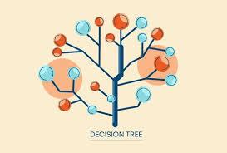


Types of Decision Tree Algorithms
ID3
CART
Classification and Regression Trees
Chi-Square
Reduction in variance

Slide 5
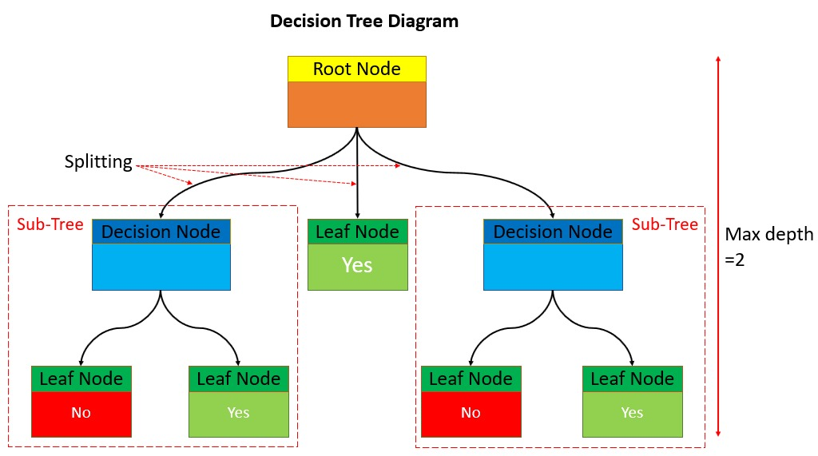
Terminologies :
Root Node: the nodes gets divided into different homogeneous nodes. It represents the entire sample.
Splitting: It’s the process of splitting or dividing a node into two or more sub-nodes.
Interior Nodes: they represents different tests on an attribute.
Branches: They hold outcomes of those tests
Leaf Nodes: When the nodes can’t be split further, they are called leaf nodes.
Parent and Child Nodes: The node from which sub-nodes are created is called a parent-node. And, the sub-nodes are called the child nodes.
5

Slide 6
How Does a Decision tree in ML work?
The process of training and predicting the target features using a decision tree in ML is given below:
Feed a dataset, containing a number of training instances, with a set of features and target.
Train the decision tree classification or regression models with the help of DecisionTreeClassifier() or DecisionTreeRegressor() methods and add the required criterion while building the decision tree model
Use Graphviz to visualize the decision tree model.

Slide 7


Advantages
Easy to Understand:
Visualization of solution is achievable once the model is created.
2. No Assumptions:
Doesn’t make any assumption about data. Known as CART.
3. Performance:
Performance doesn’t get affected by non-linear parameters.

Slide 8
Disadvantages
Overfitting :
Decision trees can easily be overfit when the tree is too complex or when there is irrelevant data in dataset.
2. Bias:
Decision trees can be biased towards features that appear earlier in the tree or have more splits.
3. Unstable algorithm:
Small variation in data can lead to different tree structures. Which in turn can make things difficult.
4. Limited expressiveness:
Not well suites for complex problems with continuous data.

Slide 9
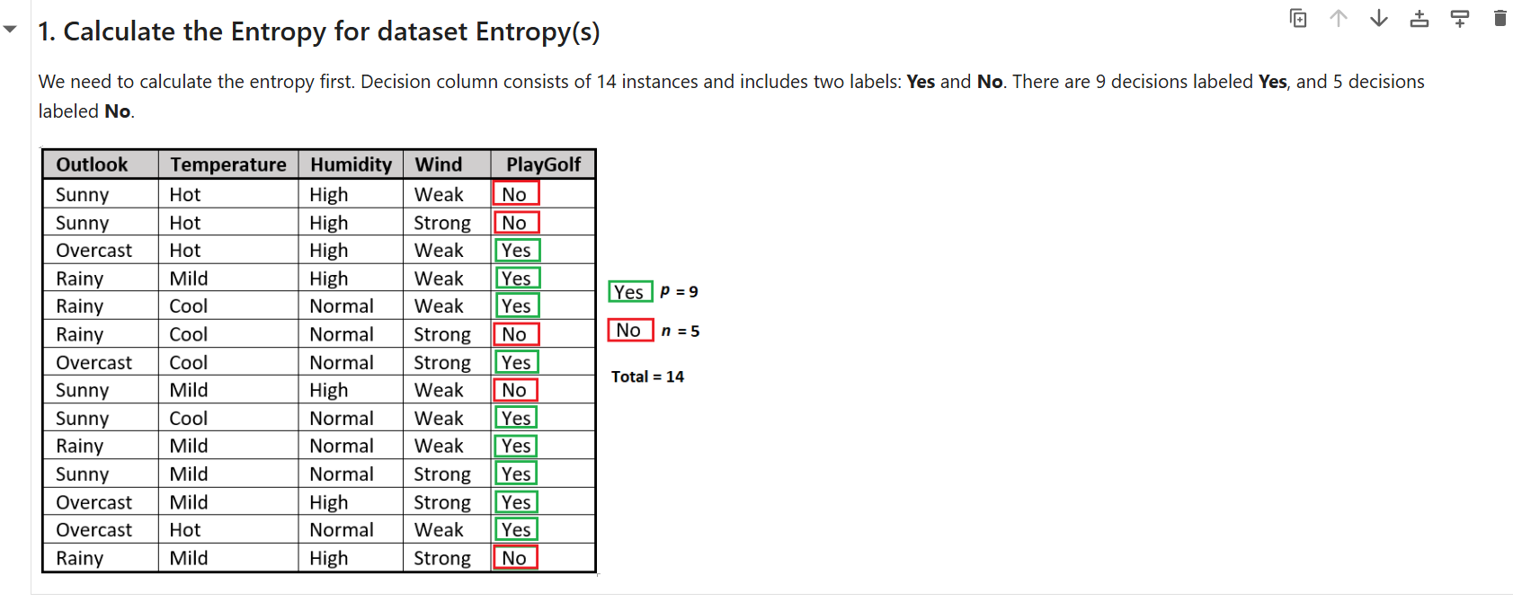
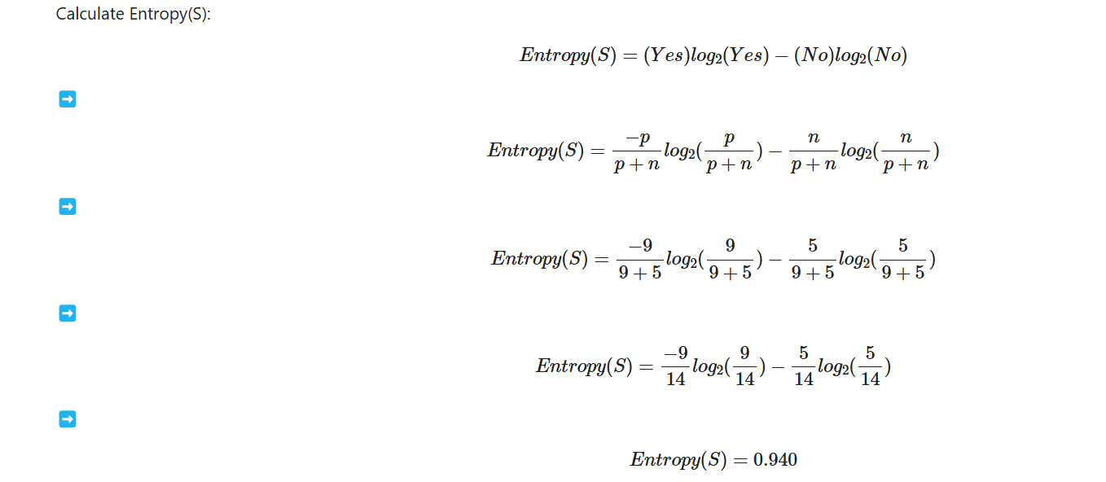

Slide 10
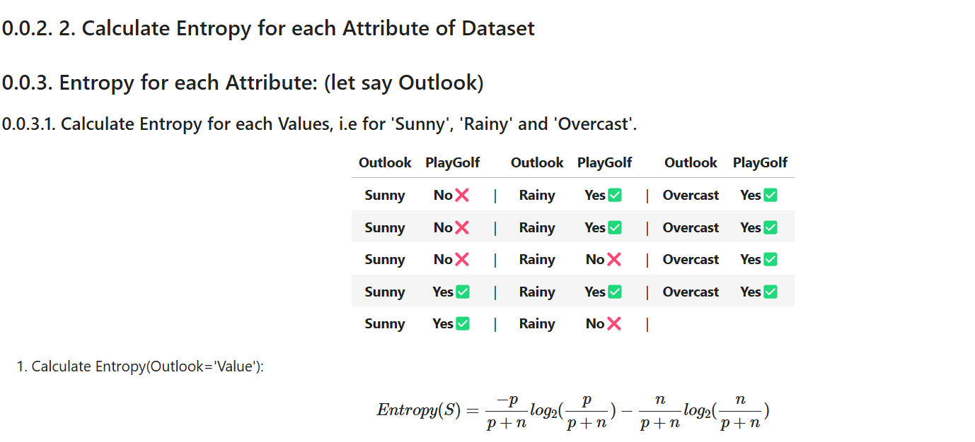
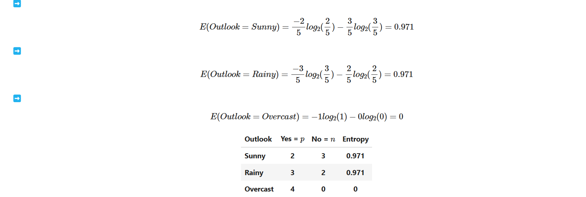

Slide 11
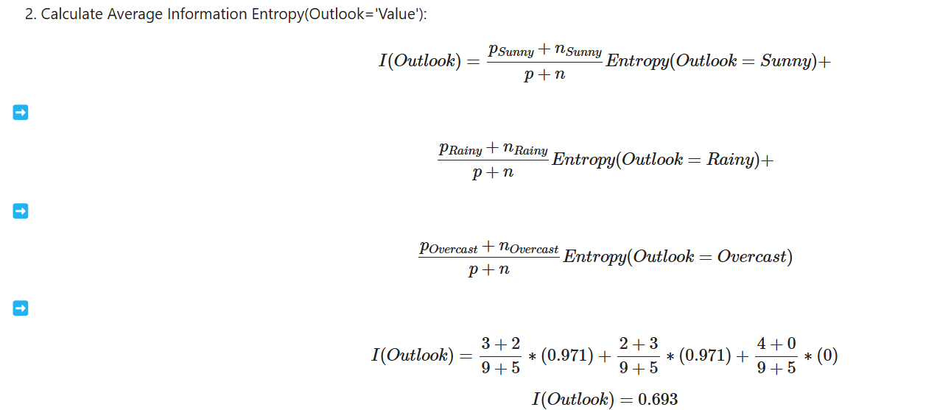

Slide 12
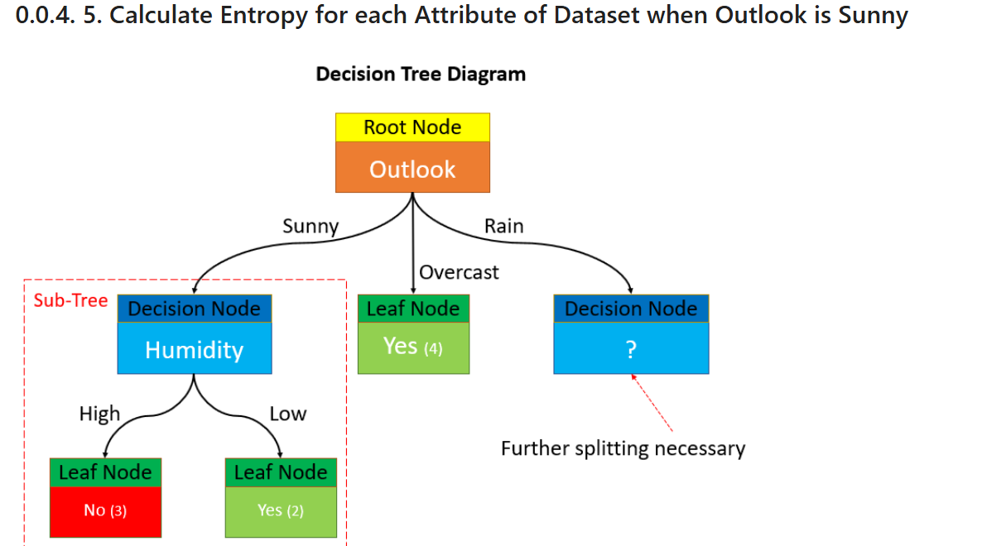

Slide 13
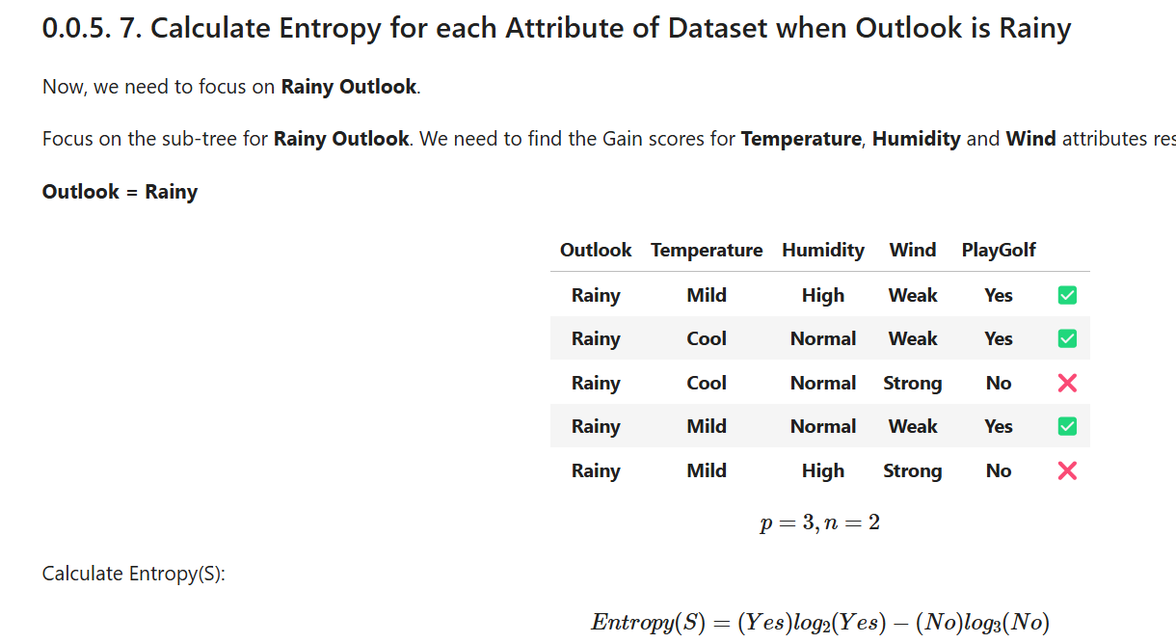
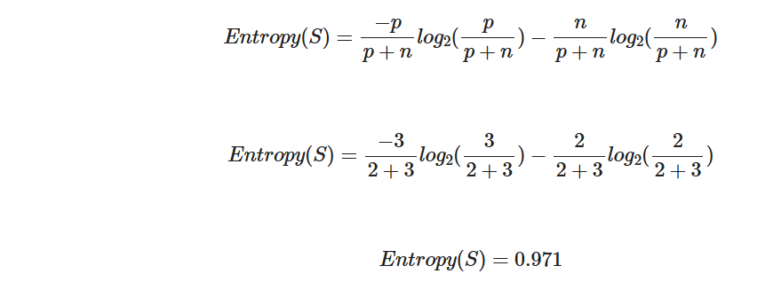

Slide 14
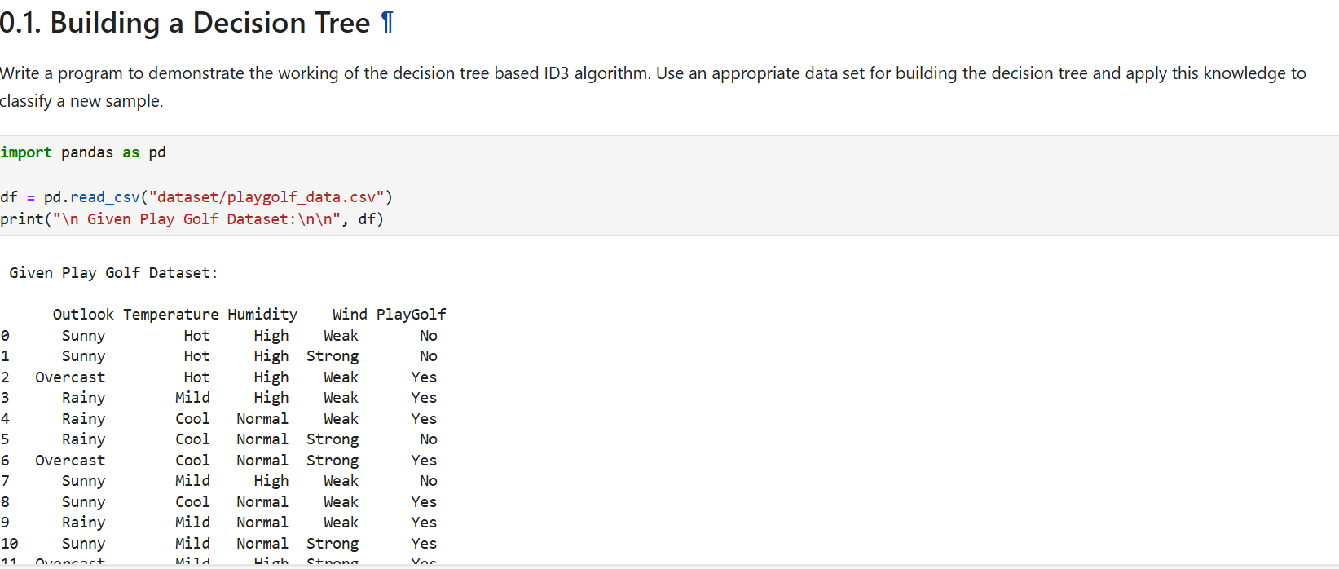

Slide 15
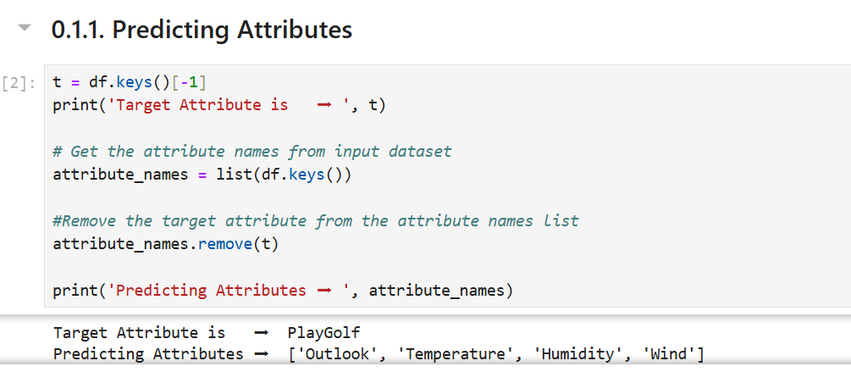

Slide 16
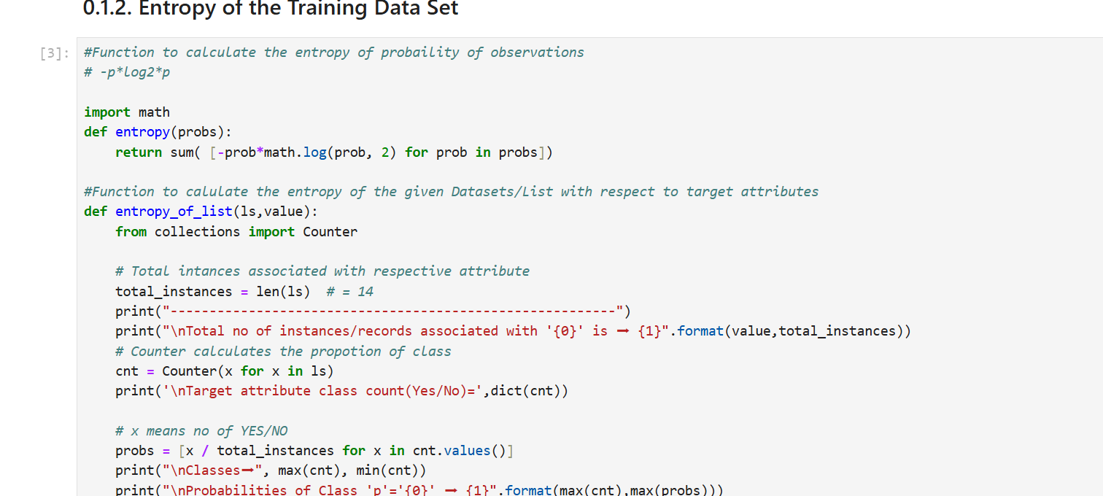

Slide 17
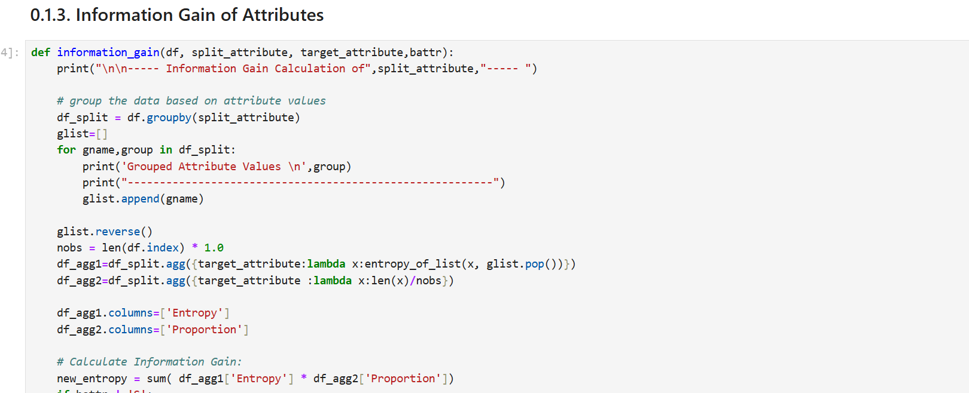

Slide 18
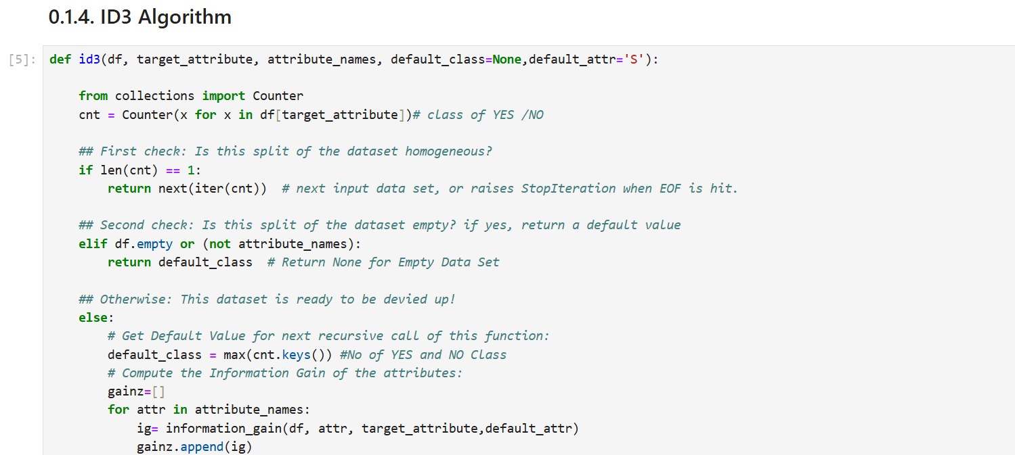
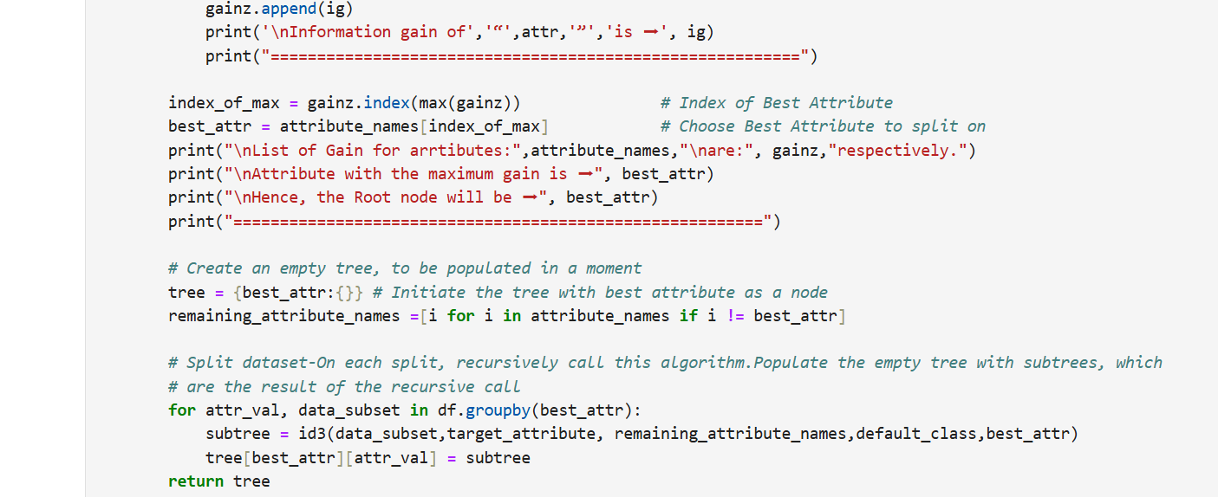

Slide 19
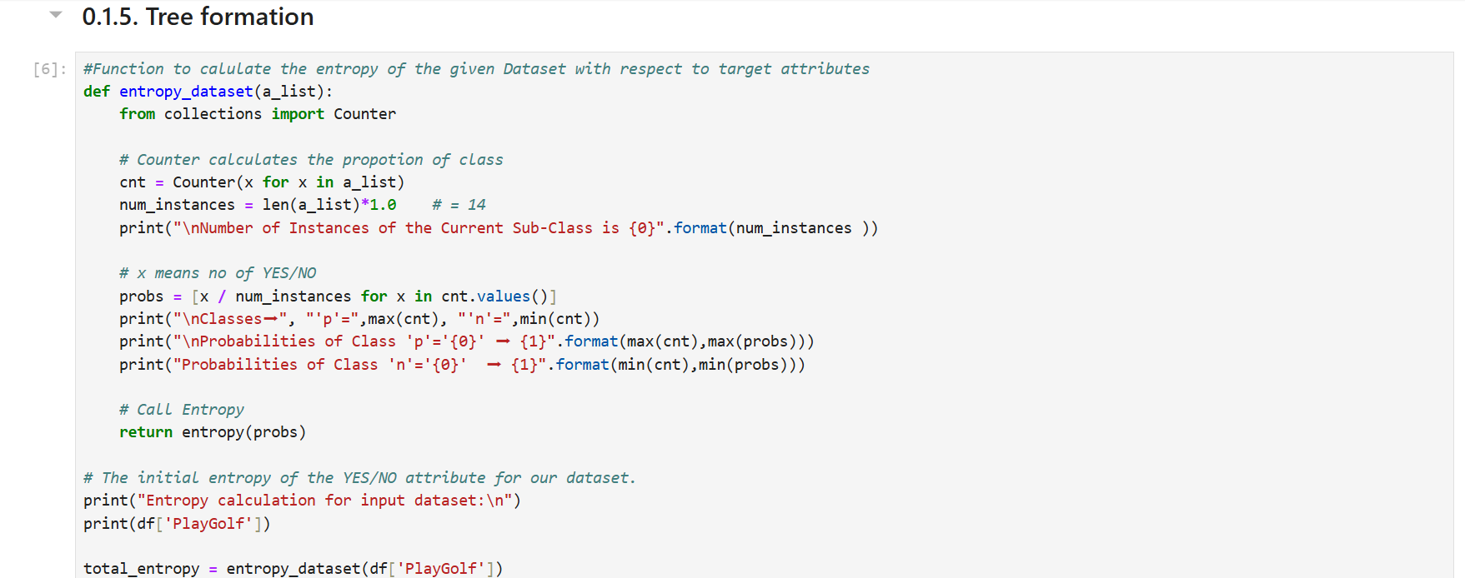

Slide 20
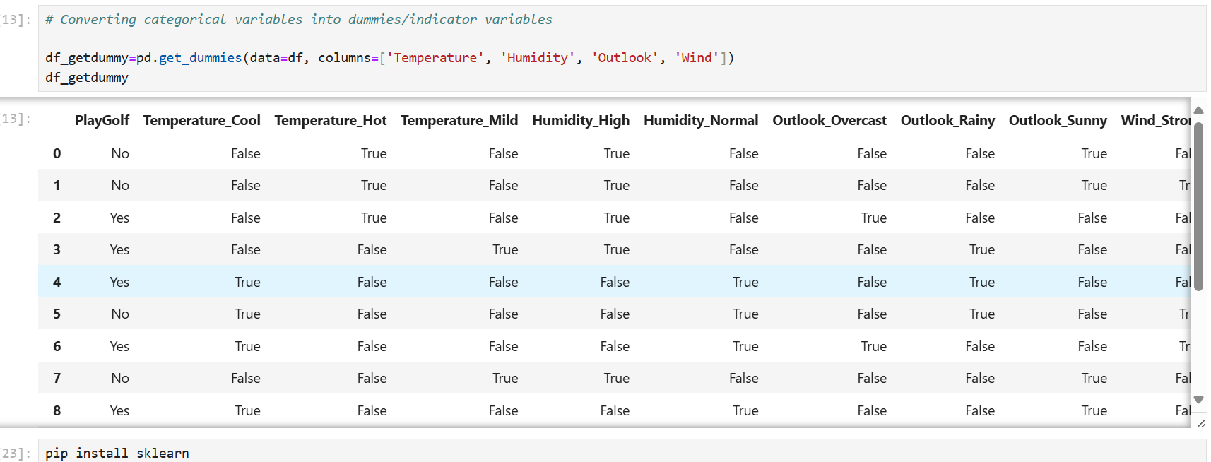

Slide 21
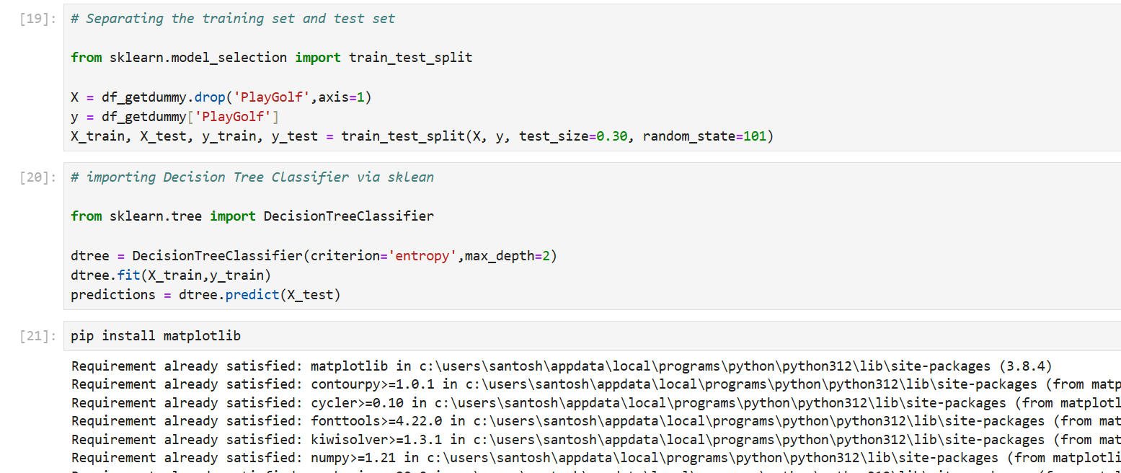
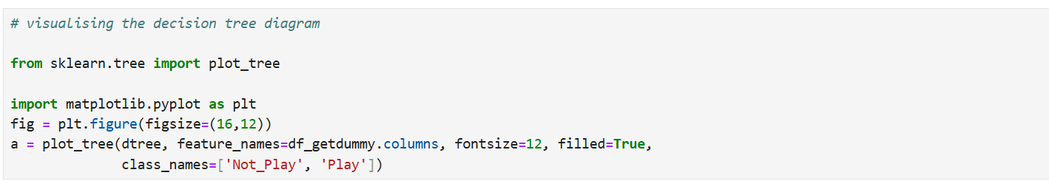

Slide 22
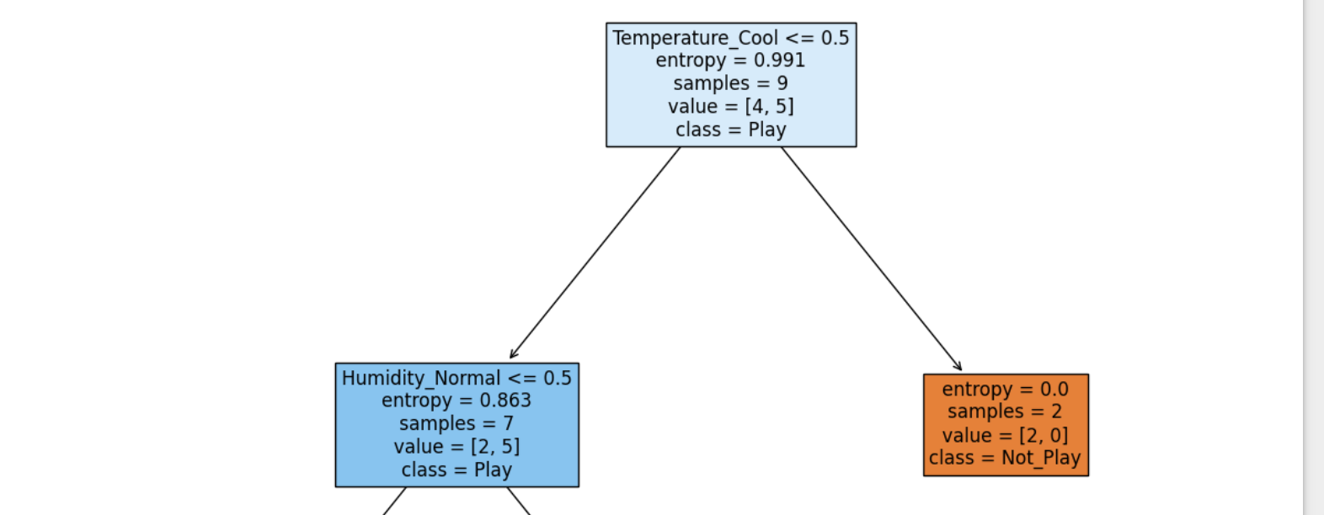

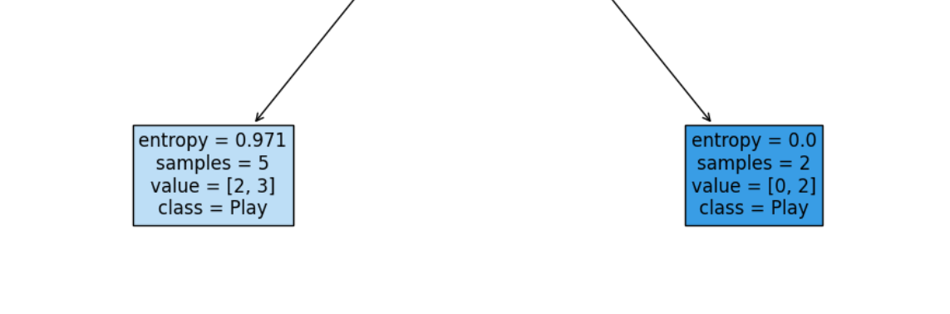

Slide 23

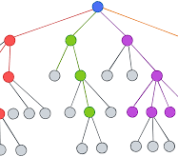
Thank you

